Slide 1
Git i Visual Studio 2013
Terje Sandstrøm
Visual Studio ALM MVP
http://geekswithblogs.net/terje
Inmeta Consulting AS
Lars J. Nilsson
ALM Manager
http://larzjoakimnilzzon.blogspot.no/
Inmeta Consulting AS

Slide 2

SHAMELESSLY
borrowed from
Richard Banks
Visual Studio ALM MVP, Australia
http://www.Richard-banks.org
Http://www.readify.net/
Which again has …….

Slide 3

SHAMELESSLY
borrowed from
SCOTT
CHACON
(https://github.com/schacon/git-presentations
http://git-scm.com

Slide 4
Git – intro
Git repositories
Working with git
Branching
Git in the Enterprise

Slide 5
git is
NOT AN
EVOLUTION
of existing VC systems
1

Slide 6
It is a
RETHINK

Slide 7
git is
NOT A
SOURCE CONTROL
SYSTEM
2

Slide 8
git is a
CONTENT
CONTROL SYSTEM

Slide 9
GIT is a
Distributed Version Control System
Fast, Small, Distributed
http://gitscm.com/
The entire Pro Git book written by Scott Chacon is available to read online for free. Dead tree versions are available on Amazon.com.

Slide 10
GIT DESIGN

Slide 11
a
TOOLKIT
for a DVCS

Slide 12
many chainable
COMMANDS

Slide 13
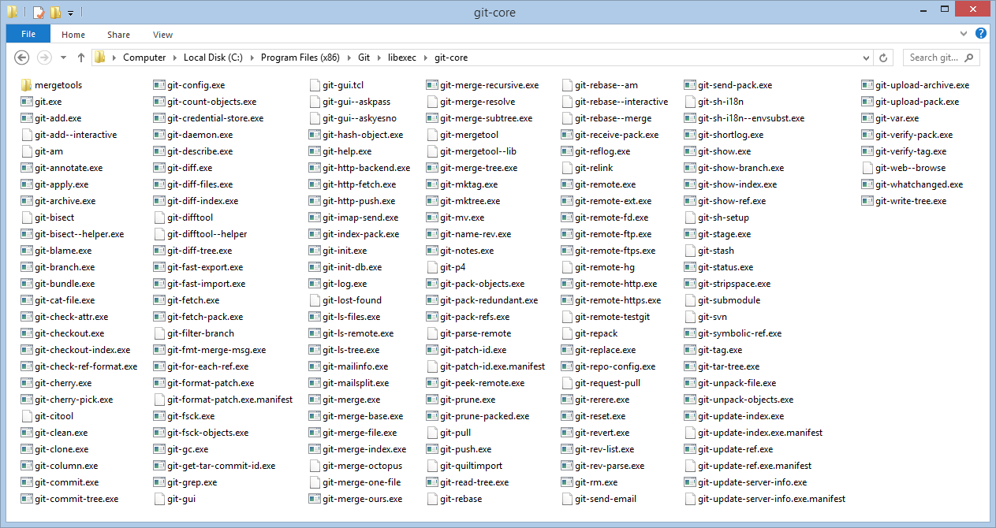
YIKES!!!!

Slide 14
Traditional GIT is:
big on the
POWER
small on the
friendly

Slide 15
Easier tools
Visual Studio 2012 with Git extensions
Visual Studio 2013 , Git is included OOB
Add some nice tools:
SourceTree, Atlassian
https://github.com/Inmeta/Knowledge/wiki/recommended-git-tools

Slide 16

Git fully integrated into Visual Studio and TFS

Slide 17

Fully integrated Git support
Team Explorer
TFS SCC Provider
Git SCC Provider
TFVC Object Model
LibGit2 / LibGit2Sharp
Team Foundation Server / Service
Local Repo
Project 1
Project 2
Issues
Project Mgmt
Build
…
Issues
Project Mgmt
Build
…
3rd Party
3rd Party
Other Remote Git Repo
Eclipse
XCode
Shell
Eclipse
TFVC
Git
Shell
…
…
Git-TF

Slide 18
most version control
systems store and track
CHANGES
(e.g. TFVC, SVN, mercurial)

Slide 19
C1
C2
C3
C4
C5
A
∆1
∆3
∆4
B
∆2
∆4
C
∆1
∆2

Slide 20
Git stores
SNAPSHOTS
of content

Slide 21
Snapshots are stored in a
DIRECTED ACYCLIC GRAPH
(i.e. a graph database)

Slide 22
C1
C2
C3
C4
C5
A
A’
A’
A’’
A’’’
B
B
B’
B’
B’’
C
C’
C’’
C’’
C’’

Slide 23

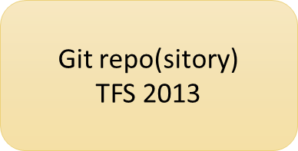

Git repo(sitory)
GitHub/CodePlex/Bitbucket
Git repo(sitory)
TFS 2013
Cloning
Fetch, Pull, Push
Git repo(sitory)
Local
Commit, (Stage), Add
Code
Workspace
Inmeta Consulting AS - Terje Sandstrøm 2013

Slide 24
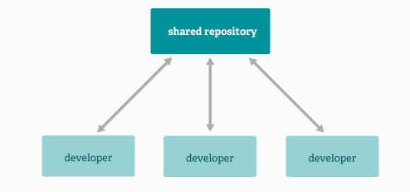
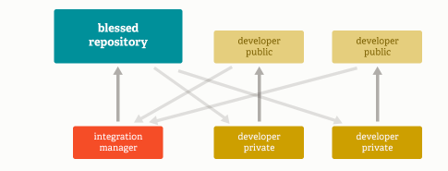
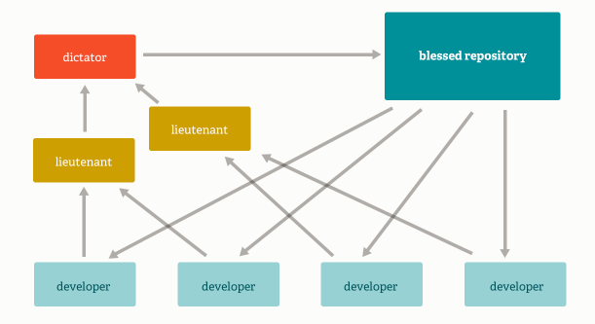
Repository models
Integration Manager Workflow
Aka Github-style, Open Source
Std
Massive Projects

Slide 25

Branching and merging
Frictionless context switching
Flexible
Fast

Slide 26
Demo

Slide 27
Terms with different meanings
Action | TFS VC | Git | VS Git
Open a file | Checkout | NA, you just open it | Marked as touched (like checkout in TFS VC)
Get latest files from server | Get Latest | Fetch + Pull | Fetch + Pull
Send files to server/repo | Checkin | Commit + Push | Commit + Push
Update all (two above) | NA | NA | Sync Does Pull + Push, may trigger a merge
Move focus to another branch | Manually change folder in SC | Checkout | Switch

Slide 28
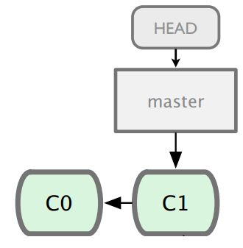

Slide 29
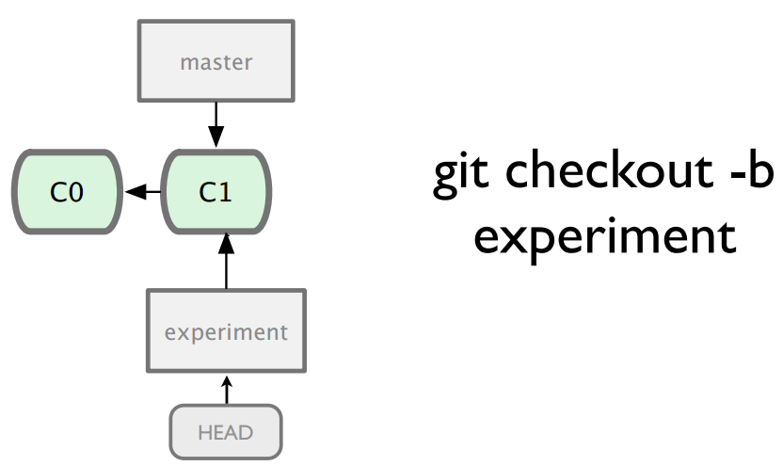

Slide 30
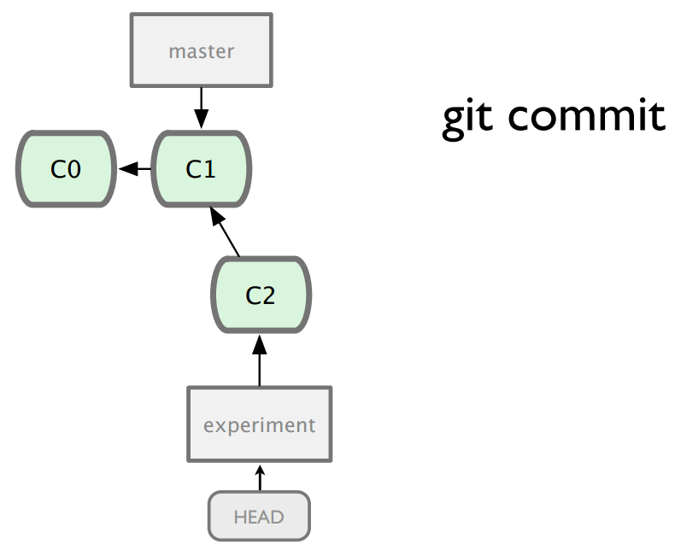

Slide 31
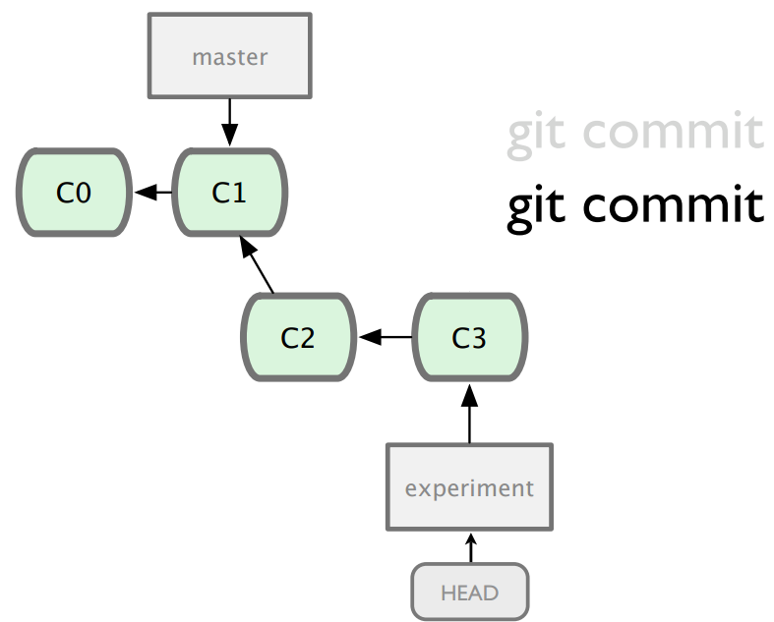

Slide 32
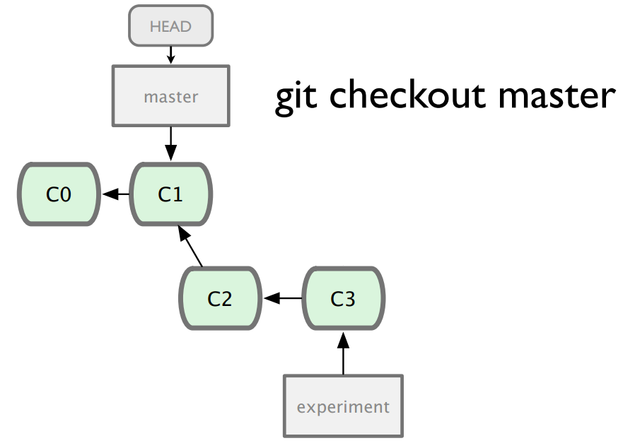

Slide 33
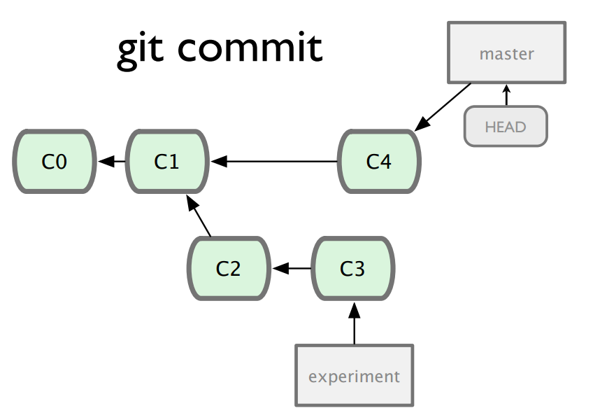

Slide 34
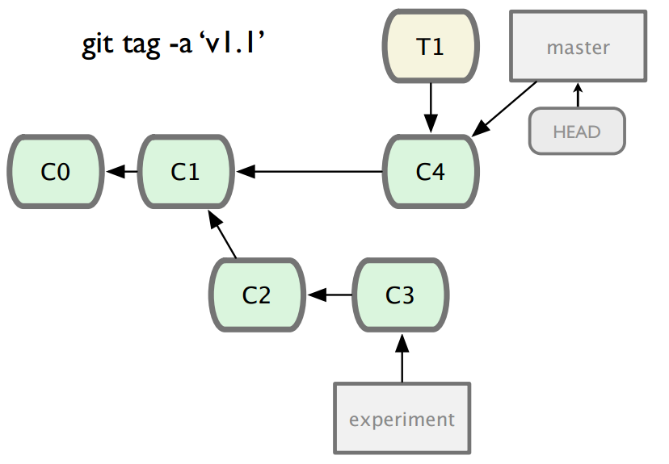

Slide 35
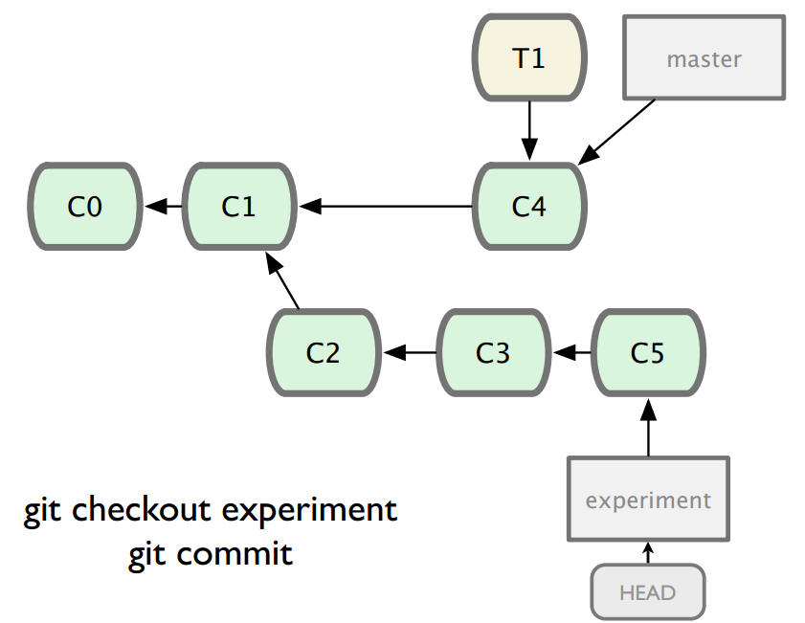

Slide 36
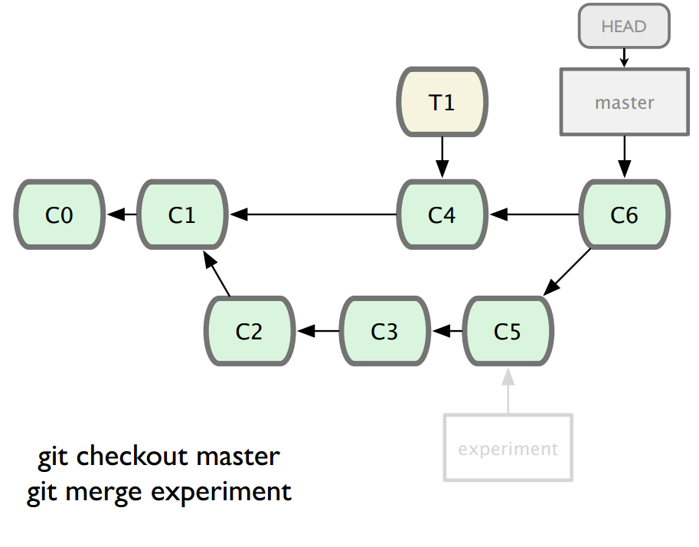

Slide 37
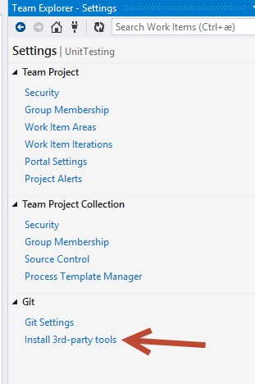
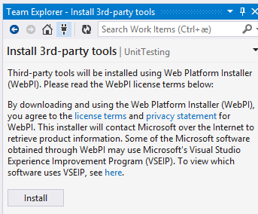
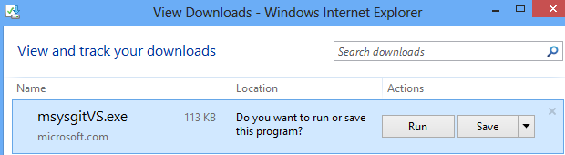
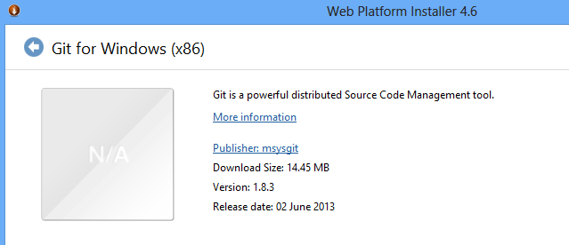
Setup

Slide 38
Git in the Enterprise
Git is small
Enterprises are big
Enterprises are many small gits

Slide 39
Keep the git repo’s small
NO BINARIES IN SOURCE CONTROL !!!!!!!!!!!!
Use Nuget (or some other package manager) to keep binaries out
See https://github.com/Inmeta/Knowledge/wiki/NuGet-Setup
Publish your own libraries to a Nuget feed
Use MyGet http://www.myget.org/
Host your own Nuget feed, see http://blog.spinthemoose.com/2013/03/09/nuget-tip-2-run-your-own-package-feed/
Inmeta Consulting AS - Terje Sandstrøm 2013

Slide 40
Managing a System with Git and Nuget
Split System into multiple Applications
Place each application in its own Git repository
Use a package manager to publish the binaries locally (within the company)
Use automatic package restore to retrieve them on build
Inmeta Consulting AS - Terje Sandstrøm 2013

Slide 41
Migrating from (or coexisting with) TFSVC to GIT
Use Git-tf: https://gittf.codeplex.com/
(Download: http://www.microsoft.com/en-us/download/details.aspx?id=30474)
Clone a TFSVC TP or parts of a TP, into a git repo
Shallow clone or Deep Clone
Works on Windows and Mac
Inmeta Consulting AS - Terje Sandstrøm 2013

Slide 42
Splitting and merging repos
Split a repo:
Merge two repos:
Multiple ways:
1) simple with dual remote repos and just merge them
2) Git subtree
http://stackoverflow.com/questions/1425892/how-do-you-merge-two-git-repositories
Inmeta Consulting AS - Terje Sandstrøm 2013

Slide 43
Git repo(sitory)
GitHub/CodePlex/Bitbucket
Git repo(sitory)
TFS 2013
Git repo(sitory)
Local
Fetch, Pull, Push
Git repo(sitory)
Local
Git repo(sitory)
Local
Commit, (Stage), Add
Code
Workspace
Inmeta Consulting AS - Terje Sandstrøm 2013

Slide 44
The future of Version Control in TFS
Then:
We had: Source Safe
We got : TFS VC
Now:
We have: TFS VC
We got: Git
Future: Microsoft hasn’t said, but we can assume.....
Inmeta Consulting AS - Terje Sandstrøm 2013

Slide 45
The End
http://geekswithblogs.net/Terje

